Slide 1






MACHINE LEARNING
PROJECT
By ALVIN, VANSH AND AKASHDEEP

Slide 2
TABLE OF CONTENTS
Introduction
Project Overview
EDA Overview
Challenges
Results
Timeline
Conclusion

Slide 3

INTRODUCTION
The task is to collect accurate and abundant data for small Canadian communities and derive useful insights to support their local initiatives.
Our aim is to study rental property trends in Ontario, paying close attention to small communities. Our goal is to provide valuable insights to stakeholders, helping them make informed decisions about real estate in Ontario's smaller towns and cities.

Slide 4

PROJECT OVERVIEW
01
02
03
04
Collecting Dataset
Data preparation and Visualizing the insight.
Implementing Machine Learning Model.
Model iteration and deployment

Slide 5
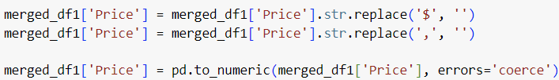

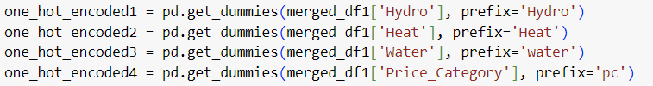

EDA OVERVIEW
Collecting dataset
Merging the additional dataset
Correcting the format
Imputing the missing values
Feature selection.
Encoding

Slide 6
MACHINE LEARNING
Problems We faced in Machine learning
Dataset | Score | Measurement
Small community data | 49 | Accuracy
Medium community data | 53 | Accuracy
Large community data | 62 | Accuracy
Very large community data | 56 | Accuracy
Inefficient ML model: Poor model performance on small community dataset.

Slide 7

MACHINE LEARNING
How We Solved Problems
Model Iteration: We changed the Hyperparameter for the ML
Cross Validation: To deal with overfitting instead of splitting train and test into 80/20, We used Cross-validation

Slide 8
TOP 3 BEST-PERFORMING MODELS
Model | Score | Evaluation & Metrics
Random Forest Classifier | 0.996 | Accuracy
GradientBoostingClassifier | 0.997 | Accuracy
GradientBoostingRegressor | 0.67 | R_square

Slide 9
BEST PERFORMING MODEL
Random Forest Classifier
Hyperparameter we choice
'max_depth': None, 'min_samples_leaf': 2, 'min_samples_split': 2, 'n_estimators': 100
Cross validation is 5

Slide 10

Deployment

Slide 11
Timeline
Preparation Phase
EDA
Feature Engineering
Model Deployment

Slide 12



CONCLUSIONS
In conclusion, despite encountering numerous challenges throughout our project such as handling missing values and working with a small dataset, we managed to produce results for our machine learning analysis on the small community dataset.
This course has been incredibly providing us with invaluable lessons that have deepened our understanding of machine learning. Overcoming these obstacles has not only been rewarding but has also reinforced our knowledge and skills in this field. Moving forward, we're excited to apply what we've learned to future projects and continue our journey of learning and growth in machine learning.

